Slide 1
Variables etc…

Slide 2
Topics
Variables
Constants
Data types
Declaration

Slide 3
Variables
A symbol or name that stands for a value.
A variable is a value that can change.
Variables provide temporary storage for information that will be needed during the lifespan of the computer program (or application).

Slide 4
Variables
Example:
z = x + y
This is an example of programming expression.
x, y and z are variables.
Variables can represent numeric values, characters, character strings, or memory addresses.

Slide 5
Variables
Variables store everything in your program.
The purpose of any useful program is to modify variables.
In a program every, variable has:
– Name (Identifier)
– Data Type
– Size
– Value

Slide 6
Types of Variable
There are two types of variables:
– Local variable
– Global variable

Slide 7
Types of Variable
Local variables are those that are in scope within a specific part of the program (function, procedure, method, or subroutine, depending on the programming language employed).
Global variables are those that are in scope for the duration of the programs execution. They can be accessed by any part of the program, and are readwrite for all statements that access them.

Slide 8
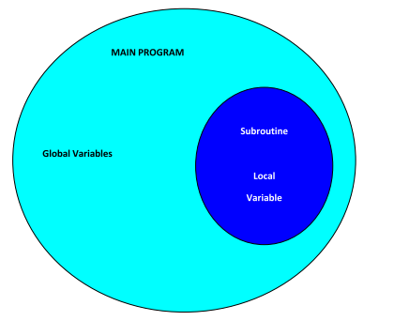
Types of Variable

Slide 9
Rules in Naming a Variable
There a certain rules in naming variables (identifier).
They are:
– It should use only alphabets, number and underscore ( _ )
– It should not begin with a number and must have at least one alphabet.
– It should not be a reserved word.
Examples of reserved word:
main long if do continue short else return
const int double break void char

Slide 10
Rules in Naming a Variable
Following are some valid identifiers:
x number1 a123 number_2 _xyz
Following are some invalid identifiers:
print main space not allowed
123number name should not begin with number
main reserved word

Slide 11
Constants
The opposite of a variable is a constant.
A constant is a value that never changes.
Because of their inflexibility, constants are used less often than variables in programming.
A constant can be :
– a number, like 25 or 3.6
– a character, like a or $
– a character string, like "this is a string"

Slide 12
Constants
Example:
– Calculate area of circle
area = 3.142 * r * r
• Variable:
– area, r
Constant – 3.142

Slide 13
Data Types
Data type is classification of a particular type of information.
Data types are essential to any computer programming language.
Without them, it becomes very difficult to maintain information within a computer program.
Different data types have different sizes in memory depending on the machine and compilers

Slide 14
Data Types
Integer
Floating-point
Character
String
Boolean

Slide 15
Integer
A whole number, a number that has no fractional part.
The following are integers:
0 1 -125 144457
In contrast, the following are not integers:
5.34 -1.0 1.3E4 "string“
There are often different sizes of integers available; for example, PCs support short integers, which are 2 bytes, and long integers, which are 4 bytes.

Slide 16
Floating-point
A number with a decimal point.
The following are floating-point numbers:
3.0 -111.5
Floating-point representations are slower and less accurate than fixed-point representations, but they can handle a larger range of numbers.
It requires more space.

Slide 17
Character
In graphics-based applications, the term character is generally reserved for letters, numbers, and punctuation..
It only can represent single character.
The following are characters
a A @ $ 2

Slide 18
String
String is a sequence of character.
Example:
– Kuala Lumpur
– John White
– Computer

Slide 19
Boolean
This data type only have two possible values:
– True
– False
Use this data type for simple flags that track true/false conditions.

Slide 20
Declaration
In programming languages all the variables that a program is going to use must be declared prior to use.
Declaration of a variable serves two purposes:
– It associates a type and an identifier (or name) with the variable. The type allows the compiler to interpret statements correctly.
– It allows the compiler to decide how much storage space to allocate for storage of the value associated with the identifier and to assign an address for each variable which can be used in code generation.

Slide 21
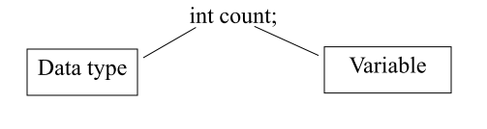
Declaration
A typical set of variable declarations that might appear at the beginning of a program could be as follows:

Slide 22
Declaration
Often in programming numerical constants are used, e.g. the value of  (pi = 3.14).
It is well worthwhile to associate meaningful names with constants.
These names can be associated with the appropriate numerical value in a constant declaration.
The names given to constants must conform to the rules for the formation of identifiers as defined above.

Slide 23
Declaration
The following constant declaration:
const int days_in_year = 365;
The general form of a constant declaration is:
const type constant-identifier = value ;

